Slide 1
Westeren Man
HackTUES project by
“tova mai ne e aniven4era”

Slide 2
Идеята
2D platformer
+
Raspberry PI 3
+
controller
=
New console with oldschool game

Slide 3
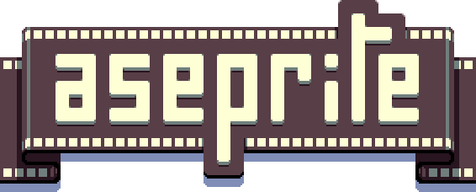

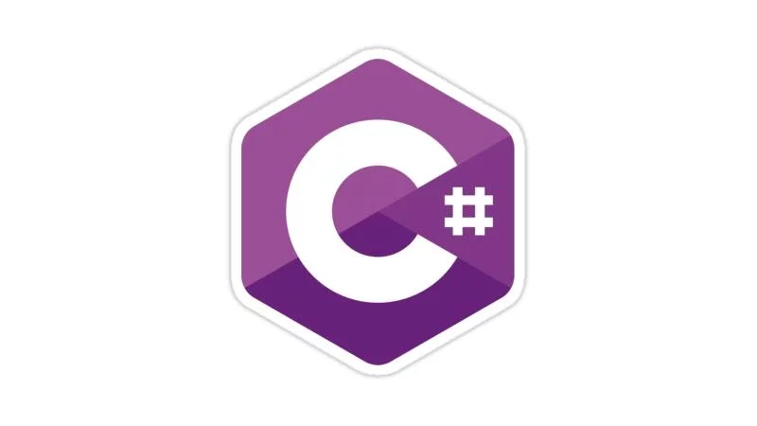

Използвани технологии :

